Slide 1
Progress Report
Tommy XIN
John WU
Felix FAN

Slide 2
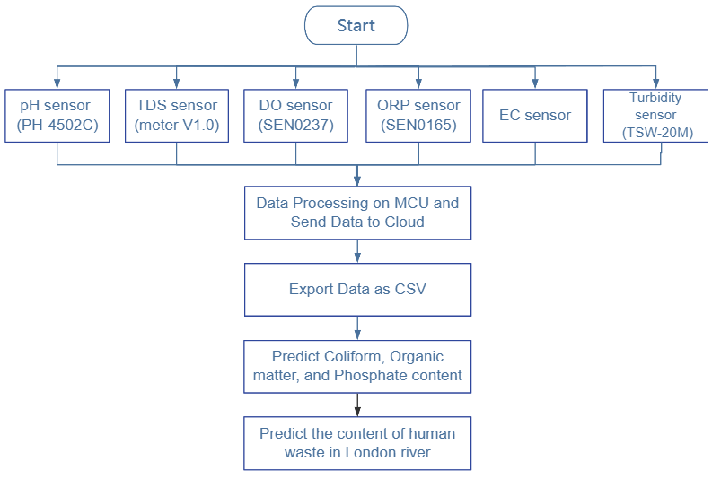
Detection Progress
Can Add More Sensors e.g. Temperature
Need to be Confirmed by More Research

Slide 3
Detection Progress
Sensors | Detection range | Resolution | Accuracy (25℃)
PH-4502C (pH) | 0-14 pH | 0.01 pH | ±0.1 pH
TSW-20M (Turbidity) | 0-4550 NTU (0%-3.5%) | 4.5 NTU
TDS Meter V1..0 (TDS) | 0-1000 ppm | 1 ppm | ±10% FS
EC sensor (EC) | 0-1000 ppm | 1 ppm | ±10% FS
SEN0237 (DO) | 0~20 mg/L | 0.02 mg/L
SEN0165 (ORP) | -2000 mV-2000 mV | 2 mV | ±10 mV

Slide 4
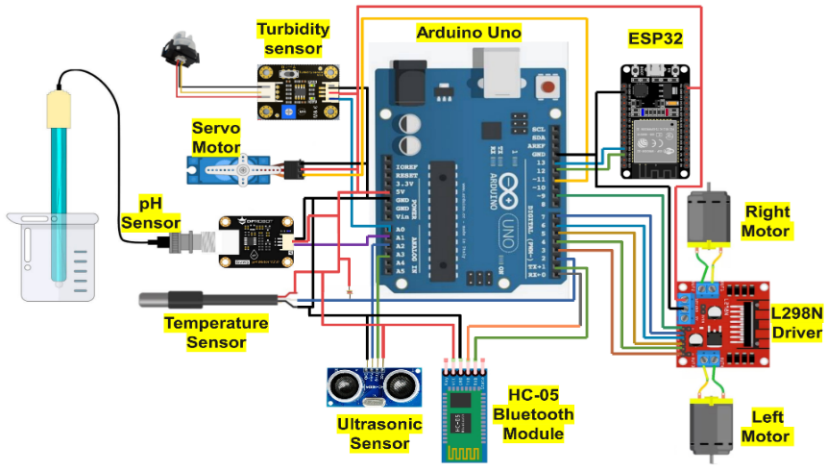
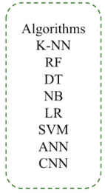
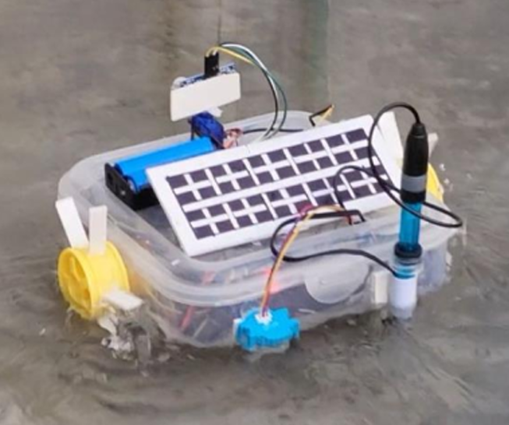
Future Plan
Sensors
pH, TDS, Turbidity, EC, DO, and Oxidation-Reduction Potential
Prediction Tasks
Predict the value of certain index (e.g. coliform)
Classify whether the water is potable
Data Collecting
Model Training
Deploy multiple systems
Feature extraction
Build system
Test single system
Data segmentation
Training
Test

Slide 5
Problems
Lack of dataset
Predict one water pollution index via ML
Dataset (certain index) is required
Over budget
DO and ORP probes are expensive
Equipment placement
Component Name | Price (￡)
TDS sensor | 10.39
Turbidity sensor | 14.19
Conductivity sensor | 8.07
pH sensor | 14.84
DO module | 96.41
ORP module | 66.51
Total | 210.41

